Slide 1
BSc II YEAR
Subject :Chemistry
Course Name : Chemistry of Main Group Elements, Chemical energetics and Equilibria
Paper code: CHEM 202 TH
Section :B

Slide 2
GROUP 13
(Part II)
BORON B 2s² 2p¹
ALUMINIUM Al 3s² 3p¹
GALLIUM Ga 4s² 4p¹
INDIUM In 5s² 5p¹
THALLIUM Tl 6s² 6p¹
Nihonium Nh 7s² 7p¹

Slide 3
Group 13
Topics covered
Members of Group 13
Borax
Oxides
Borohydride
Halides
BORON B
ALUMINIUM Al
GALLIUM Ga
INDIUM In
THALLIUM Tl

Slide 4
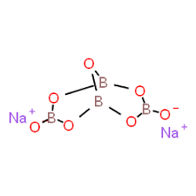
BORAX
The term borax is often used for a number of closely related minerals or chemical compounds that differ in their crystal water content:
Anhydrous sodium tetraborate, Na₂B₄O₇
Sodium tetraborate pentahydrate, Na₂B₄O₇·5H₂O
Sodium tetraborate decahydrate, Na₂B₄O₇·10H₂O or equivalently the octahydrate, Na₂B₄O₅(OH)₄·8H₂O

Slide 5
OXIDES OF BORON B₂O₃
B₂O₃ Boron trioxide is produced by treating borax with sulfuric acid in a fusion furnace. At temperatures above 750 °C, the molten boron oxide layer separates out from sodium sulfate.
Can also be prepared from boric acid by heating boric acid.
H₃BO₃ → HBO₂ + H₂O2
HBO₂ → B₂O₃ + H₂O
It is therefore also called anhydride of orthoboric acid.

Slide 6
Acidic and basic oxides
Acidic oxides are the oxides of non-metals (Groups 14-17)
Generally Group 1 and Group 2 elements form bases called base anhydrides or basic oxides .
In Group 13 elements ,Boron forms acidic oxide,Aluminium forms amphoteric oxide and Thallium forms basic oxide..

Slide 7
Basic character of oxides of group 13
The basic Character of elements depends upon the metallic character of the elements.
As the metallic character increases the basicity increases and vice versa.
For any particular group the atomic radius of the elements goes high as we go down the group. Higher radii means that it would be more and more difficult for the nucleus to dominate over the valency shell electrons. Therefore there tendency to release electrons will increase. Therefore the metallic characteristics will increase which will also increase the basicity of the oxides.
B₂​O₃​<Al₂​O₃​<Ga₂​O₃​<In₂​O₃​<Tl₂​O₃​.
It is increasing order of the basicity of the oxides of the 13 group

Slide 8
Basic nature of hydroxides of Group 13
TlOH is a strong base ,Al(OH)3 is amphoteric,B(OH)3 is Acidic.
As we move down the group from B to Al to Tl ionisation energy decreases down the group which results in weakening of M-O bond energy.As a result cleavage of M-O bond is facilitated and Tl-OH prefers to exist as Tl + and OH- .So it is a strong base.
BORON B
ALUMINIUM Al
GALLIUM Ga
INDIUM In
THALLIUM Tl

Slide 9
Aluminium oxide is amphoteric
Al₂O₃ exhibits basic behavior with H₂SO₄
Al₂O₃+3H₂SO₄→Al₂(SO₄)₃+3H₂O(basic nature)
Al₂O₃ exhibits Acidic behavior with NaOH
Al₂O₃+2NaOH→2NaAlO₂+H₂O(acidic nature)

Slide 10
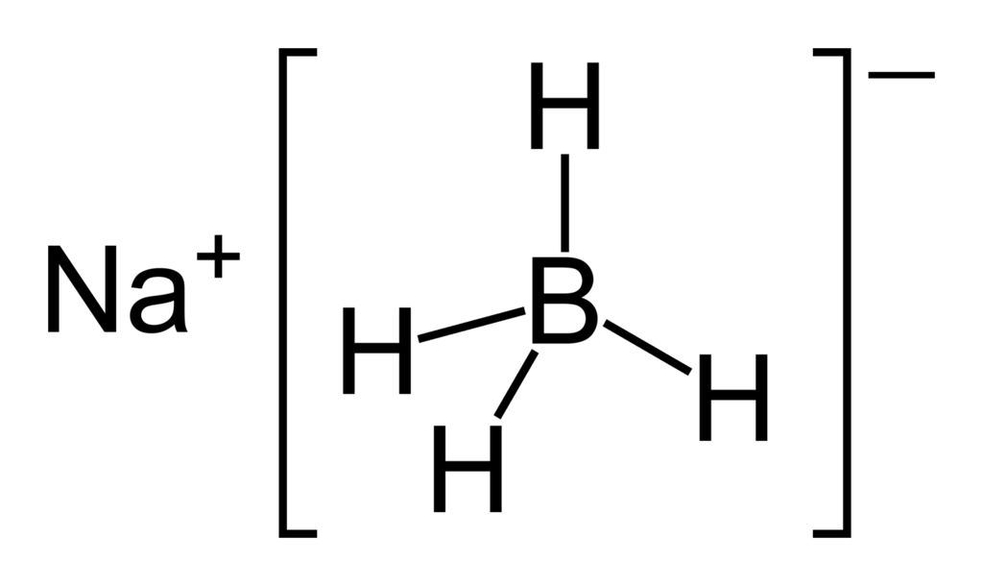
BOROHYDRIDE
Definition of borohydride
Anion BH₄⁻ of boron and hydrogen that is used especially as a reducing agent and as a source of hydrogen atoms
also : any of various compounds (as of metals) containing the borohydride anion
The most important borohydrides
lithium borohydride
sodium borohydride.

Slide 11
PREARATION OF Lithium borohydride
Lithium borohydride may be prepared by the metathesis reaction which occurs upon ball-milling the more commonly available sodium borohydride and lithium bromide:
NaBH₄ + LiBr → NaBr + LiBH₄
Alternatively it may be synthesized by treating boron trifluoride with lithium hydride in diethyl ether:
BF₃ + 4 LiH → LiBH₄ + 3 LiF

Slide 12
Properties of Lithium borohydride
Lithium borohydride is a stronger reducing agent than sodium borohydride.In mixtures of methanol and diethyl ether, lithium borohydride is able to reduce esters to alcohols and primary amides to amines.
In contrast, these substrates are unaffected by sodium borohydride. The enhanced reactivity is attributed to the polarization of the carbonyl substrate by complexation to the lithium cation.[

Slide 13
Commercial NaBH₄ production
For commercial NaBH₄ production, the Brown-Schlesinger process and the Bayer process are the most popular methods.
In the Brown-Schlesinger process Sodium borohydride is industrially prepared from sodium hydride (produced by reacting Na and H₂) and trimethyl borate at 250–270 °C:
B(OCH₃)₃ + 4 NaH → NaBH₄ + 3 NaOCH₃

Slide 14
Preparation of sodium borohydride
Bayer process is based on the reaction among borax (Na₂B₄O₇), Na, H₂, and silicon oxide (SiO₂) at 700 °C producing sodium borohydride and sodium silicate
Na₂B₄O₇ + 16 Na + 8 H₂ + 7 SiO₂ → 4 NaBH₄ + 7 Na₂SiO₃
There is currently an effort to modify the Bayer Process by employing the less expensive reducing metal magnesium (Mg) in place of sodium. Reactions such as:
8 MgH₂ + Na₂B₄O₇ + Na₂CO₃ → 4 NaBH₄ + 8 MgO + CO₂and
2 MgH₂ + NaBO₂ → NaBH₄ + 2 MgO are promising modifications to the Bayer Process.

Slide 15
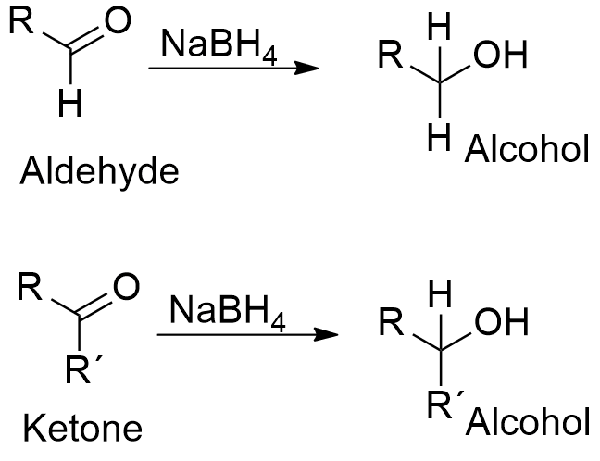
PROPERTIES OF Sodium Borohydride
NaBH₄ reduces many organic carbonyls, depending on the precise conditions. Most typically, it is used in the laboratory for converting ketones and aldehydes to alcohols. It efficiently reduces acyl chlorides, anhydrides, α-hydroxylactones, thioesters, and imines at room temperature or below.
It reduces esters slowly and inefficiently with excess reagent and/or elevated temperatures, while carboxylic acids and amides are not reduced at all.

Slide 16
Properties of borohydrides
BH₄⁻ is a ligand for metal ions. Such borohydride complexes are often prepared by the action of NaBH₄ (or the LiBH₄) on the corresponding metal halide. One example is the titanocene derivative:
2 (C₅H₅)₂TiCl₂ + 4 NaBH₄ → 2 (C₅H₅)₂TiBH₄ + 4 NaCl + B₂H₆ + H₂

Slide 17
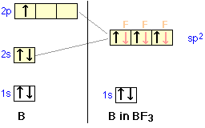
Hybridisation and bonding in Boron halides.
Boron undergoes sp2 hybridisation as shown in the figure and the three sp2 hybrid orbitals overlap with p orbitals of halogen.
Three sigma bonds are formed by boron and the shape is trigonal planar.
Besides this boron halides show back bonding to make up the electron deficiency on central boron atom.

Slide 18
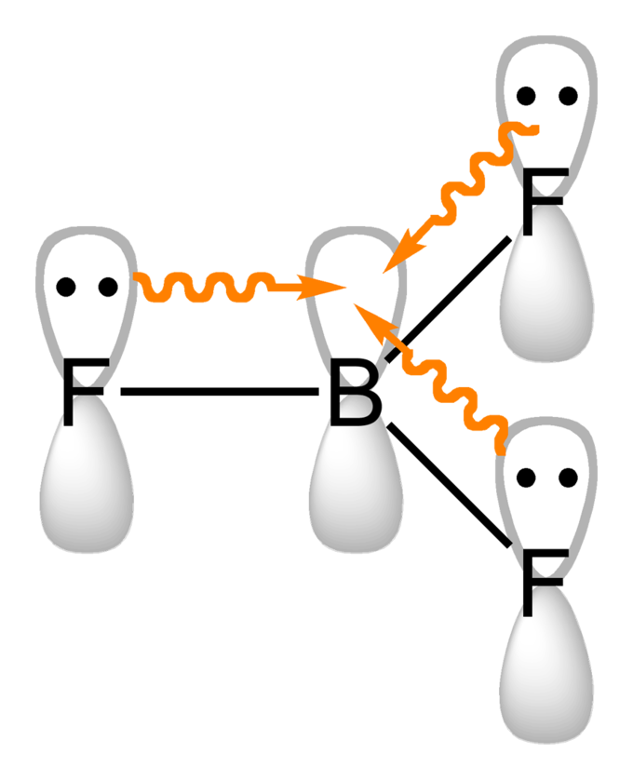
Back bonding decreases Lewis Acid character
Both Boron AND Fluorine atoms have 2p orbitals in the valence shell ,so back bonding is effective between empty unhybridised p orbital of boron and filled p orbital of fluorine. (Effective sidewise overlap due to same size of orbitals) assown in figure.
Effective back bonding compensates the electron deficiency of Boron and hence decreases Lewis acid character.

Slide 19
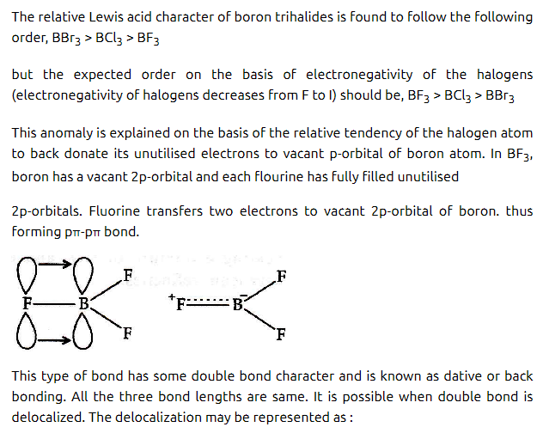
Lewis Acid Character of Boron Halides

Slide 20
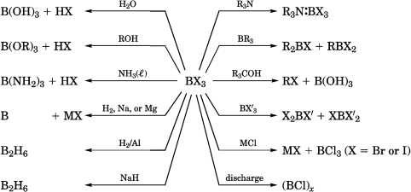
Reactions of boron halides

Slide 21
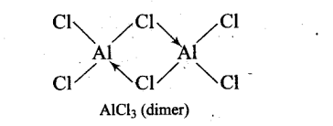
BCl₃ is monomer, AlCl₃ dimer
Boron atom is so small that it cannot accommodate four bigger sized Chlorine atoms. Due to its small size it forms strong p ∏ –p ∏ back bonding with halogens and compensates its electron deficiency.
In AlCl3 the distance between Al and Cl is large ,back p ∏ -p ∏ bonding is not effective and moreover being large in size it can easily accommodate four chlorine atoms around it ,so it forms dimer to compensate its electron deficiency.

Slide 22
Some questions for practice
Why back bonding occurs in boron halides but not in Aluminium halides?
Aluminium forms [AlF₆]³⁻ but Boron does not.
What is inert pair effect? Explain with example from group 13.
Name the element of group 13 which forms stable +1 oxidation state.

Slide 23
THANX WITH A HOPE THAT BASIC CONCEPTS OF GROUP 13 ARE CLEAR TO YOU.
Our next topic of discussion will be: GROUP 14

